Slide 1

Machine Intelligence Decision Analysis
How to apply Machine Intelligence (AI, ML, Statistics)
with Decision Theory
Bart Czernicki
Principal Technical Architect – Machine Intelligence & Analytics
@bartczernicki
Last Updated: 01.08.2020

Slide 2
Agenda – Machine Intelligence Decision Analysis
Journey & value of the talk for the audience
Contrast Rule-Based &
Machine Intelligence
Systems
Business
Decision
Validation
Decision Support &
Management
Systems
This is an advanced Machine Intelligence business conversation, not tech heavy nor will there be code
There will be multiple demos, making this real.
Collateral is available to re-deliver.

Slide 3


Microsoft AI Journey – Where to Start
AI Platform
+
Data science and Deep AI capability
Azure ML
Azure AI Infrastructure
Azure Databricks
Open Frameworks
Azure Cognitive Services
Azure Cognitive Search
AI “Accelerators”
+
Solution specific AI Services and patterns
Azure Bot Service Azure Cognitive Services
Azure Cognitive Search
AI Experience
SaaS with AI
AI Industry Accelerators
AI Solution Templates
AI Analytics Templates
Immediate actionable
insights with AI
O365 AI
D365 AI for Sales
D365 AI for Marketing
D365 AI for Cust. Service
Workplace Analytics
+
Data Estate
BI and Apps
Data-driven
Business analytics and reporting
Power BI Power Apps + Flow
Azure Data Services
SQL Server
AI Customization

Slide 4
Focus vital (and expensive) resources on core business
Purposeful Artificial Intelligence – “Simple AI”
Uber Case Study – Uber has the data science resources, but chose to leverage Microsoft
https://customers.microsoft.com/en-us/story/731196-uber

Slide 5

From Rule-based Decisions to Machine Intelligence Decisions

Slide 6
Choices present themselves with various factors leading to decisions
We (humans) are presented with choices everyday
Which route should I take to work/shopping/family?
Factors to consider
Time of Day
Construction
Any events affecting driving conditions (i.e. weather)
A straightforward drive versus complicated backroads/turns
Tolls versus FREE roads

Slide 7
Facebook uses hyper-personalization, with the ability to treat every individual uniquely
How do complex software systems make decisions?
If I claim to work from Microsoft...
Why was I served Microsoft ads?(*)
Wouldn’t it make sense to do this?
Have a rule to filter or prevent ads from showing on my Facebook feed?
If (work == “Microsoft”)
{
DoNotShowMicrosftAds();
}
The millions of manual rules that would have to be created, tested, managed, supported would be pragmatically prohibitive.
* - Until around 2018, Facebook ad serving became more autonomous and driven by Machine Intelligence decisions

Slide 8
Contrasting a Rule-based System versus a Machine Intelligence decision system
Rule-based vs Machine Intelligence Systems
Decision Systems: Rule-based vs Machine Intelligence
Rule-based System(s)
Machine Intelligence System(s)
Collective Intelligence of human domain experts is used to create artificial thresholds that form “if-then” statements. Combined these statements can form rule-based decision system(s).
Explicit rules are created, materialized & implemented into processes. Rules need to be maintained as they can change with the evolution of the domain environment.
Explaining & understanding manually created rules can be difficult & require additional statistical analysis.
Harder to maintain in the long-term with a changing domain environment.
Machine Intelligence (AI, ML, Statistics) combined with domain expertise is used to follow processes to generate models that form machine generated-decision systems.
NO explicit rules are programmed & implemented, rather systems leverage the dynamic nature of machine intelligence models and the rules are learned and constantly adapt.
Explaining & understanding generated rules can be made much easier by ML & AI explainability frameworks.
Easier to maintain in the long-term with a changing domain environment.

Slide 9
Dynamic Machine Learning Decision Tree Generated with Titanic Data Set
Decision Statements with Decision Tree Algorithms
Is Sex Male?
Yes
No
A very basic machine intelligence decision analysis system can be derived analytically using the decision tree family algorithms (AdaBoost, XGBoost, Random Forests, LightGBM etc.) to create dynamic decision statements & rules
Is Age > 9.5?
Survived – 73%
Yes
No
Perished – 17%
Number of Siblings/Spouses > 2.5?
Yes
No
Perished – 2%
Survived – 89%

Slide 10
Decision: Assign (decide) a baseball player to Hall of Fame based on career statistics
Scenario: Baseball Hall Of Fame Prediction
Rule-based using the 500 HR batter Criteria
Machine Intelligence (AI or ML) Model
Origination of the rule
Collective Intelligence of human domain experts (baseball pundits, sports journalist) that come to common understanding
Origination of the model
Machine Intelligence process (statistics, ML or AI) with domain expertise (baseball sports knowledge)
Definition of the manual rule
Summarize the entire career for the batter (add up all the batting statistics)
Extract the summarized values for Home Runs
Evaluate Statement: If (Home Runs >= 500) then assign to Hall of Fame
Definition of the generated rule via a model
No explicit rules are programmed!
The “rules” are learned via ML, statistics processes
Algorithm selection + data sampling + feature engineering + expert domain analysis
Rule-based HOF (Decision) Assignment:
Based on rule(s), retrieve assignment
No other information provided OOTB(*), needs to be manually calculated via statistics
ML Model(s) HOF (Decision) Prediction:
Calibrated Probability Threshold >= Player Probability
Probability is a value from 0.0 – 1.0
Based on a threshold decide where to assign the prediction
More advanced rule-based tests for Hall Of Fame:
Black-Ink Test, Gray-Ink Test, Career Standards Test
https://www.baseball-reference.com/about/leader_glossary.shtml

Slide 11
DEMO - Rule-based Analysis vs Machine Intelligence - Baseball Predictive What-If Decision Modeling - Decision Thresholding with Probabilities Code: https://github.com/bartczernicki/MachineLearning-BaseballPrediction-BlazorApp Live Demo: https://baseballmlworkbench-v1.azurewebsites.net/

Slide 12
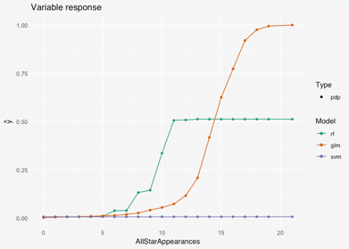
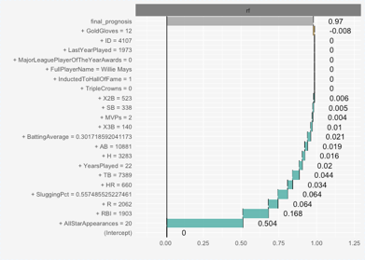
Machine Intelligence Models incorporate stochastic methods (statistical estimation)
Advantages of Machine Intelligence Models
Probability Scores & Thresholds
Performance Metrics (i.e. Accuracy, Precision, Recall, F1)
Confidence, Tolerance & Prediction Intervals
Feature Interactions (i.e. Covariance, Correlation)
Sampling & Model Error Rates
Model Explainability (Models & Predictions)
Model Governance (Ops, Feature Drift, Model Drift etc.)
Probability Breakdown(s)
...(and many more)...
This means that models based on Machine Intelligence (AI, ML, Statistics) can constantly adapt to the changing environment of the domain with new data!

Slide 13
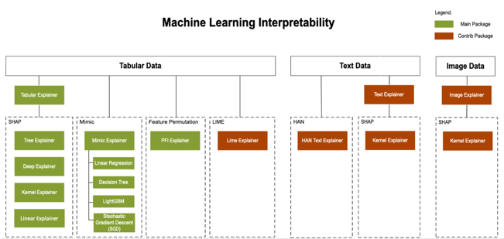
Platform to create explainable & transparent Machine Intelligence models
Azure Machine Learning Platform
https://docs.microsoft.com/en-us/azure/machine-learning/how-to-machine-learning-interpretability

Slide 14

Building valuable & useful interpretable Decision Analysis models is hard
Interpretability != Explainability
By simply reporting a bunch of explainable model metrics, graphs, statistics from a complicated model you quickly lose the initial idea of what you were trying to solve. The reasoning is not easy for humans to “understand”.

Slide 15

Scenario: Predicting recidivism – tendency whether a criminal will reoffend
High Stakes Decision Analysis
A court (judge) in the US must decide whether the incarcerated or convicted is a risk to offend when determining bail, sentence etc.
COMPAS is proprietary recidivism risk prediction tool discussed above that is in widespread use in the U.S. Justice System for predicting the probability that someone will be
arrested after their release.
”Black box” & proprietary decision system
Created by experts & criminologists
Over 130+ factors (*) used to make a decision
NOT a Machine Learning Model
“For profit” model use by various jurisdictions
Considered in areas where the “cash bail” system is being removed
Social ethics considerations
These 130+ factors (features) are manually typed into the system.
Prone to Typographical Errors – An error rate of just 1-2% can cause large inconsistencies in output (procedural unfairness)

Slide 16

Delivering simple decision analysis systems with Machine Intelligence
High Stakes Decision Analysis
CORELS Model (Machine Intelligence)
IF age between 18-20 and sex is male THEN predict arrest
(within 2 years)
ELSE IF age between 21-23 and 2-3 prior offenses THEN predict arrest
ELSE IF more than three priors THEN predict arrest
ELSE predict NO arrest
A decision analysis system created with Machine Learning delivered on a paper index card!! (no cloud, AKS, containers, GPUs, ONNX, Tensorflow etc.)
“Stop Explaining Black Box Machine Learning Models for High Stakes Decisions and Use Interpretable Models Instead”
Cynthia Rudin
https://arxiv.org/abs/1811.10154

Slide 17
Comparing complex models versus simple interpretable models
High Stakes Decision Analysis
COMPAS | CORELS
130+ factors only Might include socio-economic info Expensive (software license) software used in US Justice System | Only age, priors, (optional) gender No other information Free, Transparent
(*) Both models have similar true and false positive rates and true and false negative rates on data from Broward County, Florida.
“Stop Explaining Black Box Machine Learning Models for High Stakes Decisions and Use Interpretable Models Instead”
Cynthia Rudin
https://arxiv.org/abs/1811.10154

Slide 18
Machine Intelligence & Decision Analysis Business Decision Validation

Slide 19
Decision Transformation Journey with Analytics & AI
Business
Intelligence
What happened?
Static reports
Manual processes
Decisions
Why did it happen?
Interactive dashboards
Data
Advanced
Analytics + AI
What will happen?
Predictions
Action
What should I do?
Recommendations
Is it repeatable?
Automation
Automation
Value

Slide 20
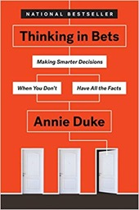
What Makes a Good Decision?
Decisions Theory helps with grasping a cleverly complex topic
Most people incorrectly correlate a “good” decision with a “positive” outcome, not a decision that was well planned, executed or implemented.
https://www.youtube.com/watch?v=CZSqjfYaX4M

Slide 21
Making AI “real” for customers
Success with Artificial Intelligence
Forrester Research – Business Value of Artificial Intelligence Technologies

Slide 22
Decision Analysis Systems
Two key types of systems that implement decision theory
Decision Analysis
Systems
Decision Support Systems(DSS)
Decision Management Systems (DMS)
Support the decision-making processes with coalescing and enhancing data -> information
Usually surfaced as a separate system outside an organization’s core business environment
Provide ”current state” information that describes the situation
Information presented leverages Business Intelligence – backwards-looking analytics
Policies, regulations & best practices are the responsibility of the expert user
Human users are expected to learn to use the system information efficiently
Previous generation surfaced through dashboards, reporting systems
Manage the decision-making processes using enhanced information management practices
Integrated into the organization’s core business environment
Can enhance the “current state” information with a recommended action (decision)
Information presented leverages forward-looking predictive analytics
Policies, regulations & best practices are built-into the decision workflow process
Learning is built-into the core of the system, allows the system to actively learn
Previous generation surfaced through enterprise business orchestration tools (BizTalk Server)

Slide 23

Job: Financial Analyst for XYZ Hedge Fund
Responsibilities:
Ryan manages 20 companies in the tech sector. For each company he has to perform the following tasks:
Read all 10K & 10Q documents and input the relevant data points into the company database.
Create Custom KPI’s that represent the valuation of the company
Search the internet, news sites and social media for any news that may impact his KPIs
Challenges:
The majority of time is taken up by ingesting \ reviewing documents.
Errors in validation calculation can result in increased company risk.
RYAN

Slide 24
DEMO - AI Decision Support System - Financial Hedge Fund Portal Live Demo: https://neu-demo-knowledge-mining-two-wbp2.azurewebsites.net/

Slide 25
Job: Mortgage Loan Officer for ABC Loans
Responsibilities: Bob processes mortgage applications for clients that have completed online applications by performing the following tasks:
Organize and validate the supplemental documents.
Creates company standard KPI’s.
Calculates the risk score.
Approves or Rejects loan.
Challenges:
The majority of time is taken up by ingesting \ reviewing documents.
Errors in validation calculation can result in increased company risk.
BOB

Slide 26
DEMO - AI Decision Management System - Mortgage & Loan Approval Live Demo: https://neu-demo-knowledge-mining-wb.azurewebsites.net/

Slide 27
How do I talk to customers about this?
Where is Machine Intelligence Decision Analysis a good fit?
Anytime there is a business process interrupted by a human having to act (make decision) on data or information, value can be attained with Machine Intelligence Decision Analysis
Example: Need more information on a stock before acting -> human checks the news cycles, researches on an internet search engine, downloads latest financial reports from 3rd party etc.
Example: Need to decide on a strategy on a legal case -> human signs into a legal case systems to search for strategies used in similar cases, applies those insights to the desired legal case
Ideal targets: Enterprises with mature business processes, large innovators/startups
Non-ideal targets: Customers that have a hype non-pragmatic expectation of AI

Slide 28


Microsoft Partner Artificial Intelligence & Advanced Analytics Archetypes Analytics maturity evolution of partners across business intelligence, deriving insights & decision analysis
Business Intelligence & Analytics
Statistics, Advanced Analytics & Cognitive AI
AI /AA – Automated Decision Analysis & Expert Information Platforms
End-to-end AA / AI platform enabling automated decision & information systems
AI / AA - Prescriptive
Advanced Statistics, Machine Learning & Custom Cognitive AI
AI / AA – Core Predictive & Cognitive
Statistical, Machine Learning & Cognitive AI
AI / AA - Diagnostic
Advanced & Interactive Business Intelligence 2.0
AI / AA - Descriptive
Basic Business Intelligence & Reporting
AI / AA - Dormant
No types of AI or AA expertise
Advanced statistics, AA & AI
Planning AI Strategy
Advanced skillsets employed
Expert Information Management
AA & AI in silos & apps
Potentially not cloud enabled
Decision Analysis: “What should we do?”
Some recommender systems
No in-house AA & AI
May not “own” data
Some basic reporting & insights delivered through 3rd party systems (i.e. payroll or POS)
Basic AA & No Cognitive AI
Can deliver historical reporting, analytics & Insights
Decision Support: “What Happened?”
Analytics & Information Strategy
Mid-Tier AA & No Cognitive AI
Primary historical analytics & insights
Decision Analysis: “What & Why Happened?”
Core AA & AI competency; non-holistic: focus on key areas
In-house capability to craft predictive models & solutions
AA & AI in silos & apps
Decision Analysis: “What will happen?”
Thought leadership in Advanced statistics, AA & AI
Executing AI Strategy
AA & AI surfaced via platform
Leveraging cloud scale
Decision Management: (Automated) “What should we do?”
Business Intelligence & Core Analytics
Infuse AA or AI
Custom AA & AI
AI Cloud Platform & GTM

Slide 29
Resources Demos, Solutions, Decision Theory, Information Management, Document Intelligence Platform

Slide 30
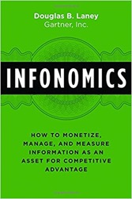
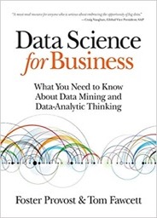
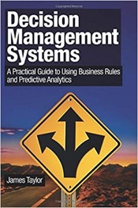
Decision Theory Book Resources
“Thinking in Bets”
Annie Duke
Excellent book about decision theory. AI and mathematics are not used nor mentioned. Understand how decisions can be validated (provided by AI DSS).
“Infonomics”
Douglas Laney
A core part of AI & ML is data and algorithms. This business focused resource helps executives understand howto craft a data strategy and be ready to layer over AI.
“Data Science for Business”
Foster Provost
Great resource for technical leader (execs) looking to understand practical data science. Book covers ”business” scenarios seen in data science. Some formulas and light math is used.
“Decision Management Systems”
James Taylor
The difference with this book is it covers the subject around “decisions” not AI or analytics specifically. This allows non-technical people understand how these systems are built to differentiate in their organizations.

